Slide 1
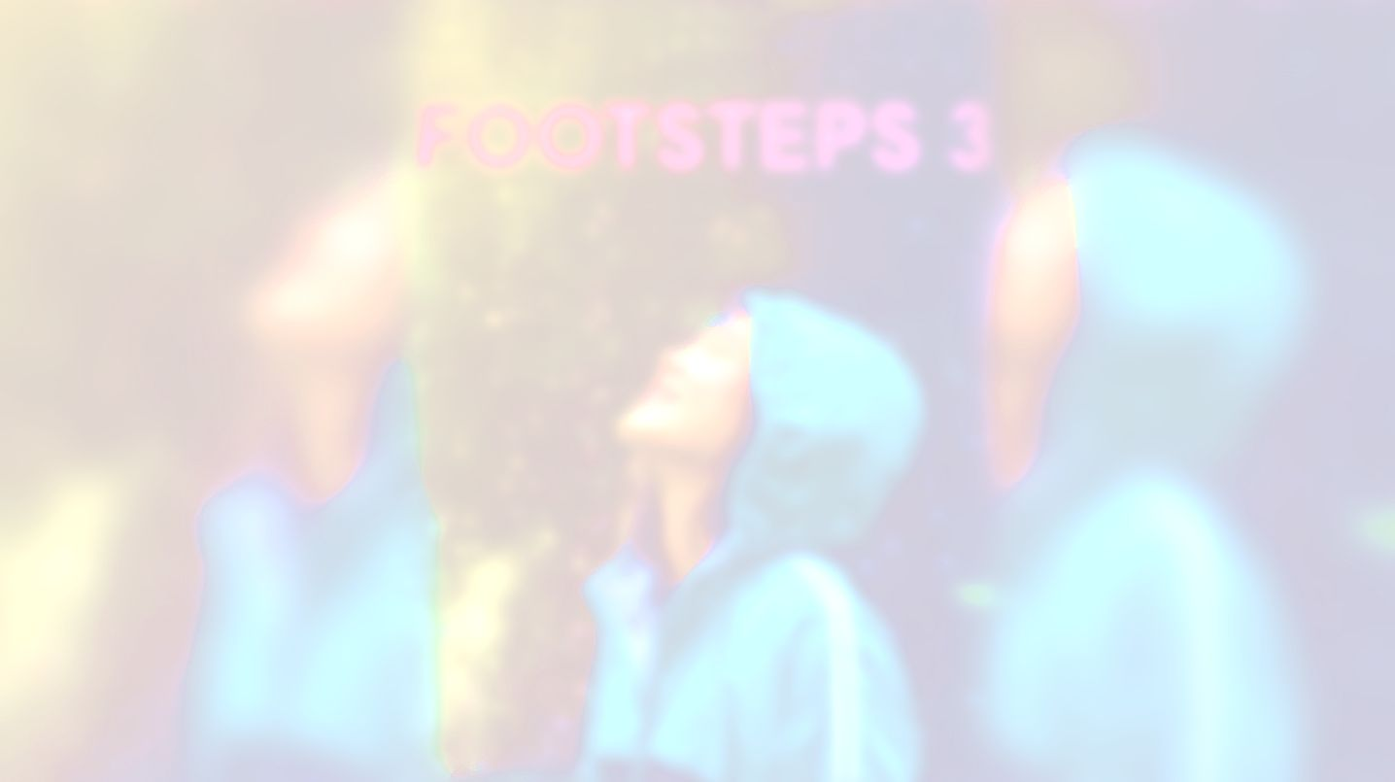

UNIT 1;
With you from the start
Too many

Slide 2
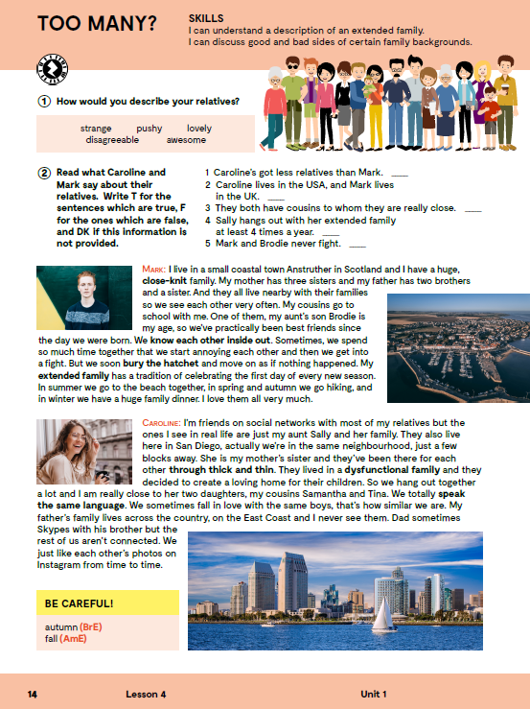
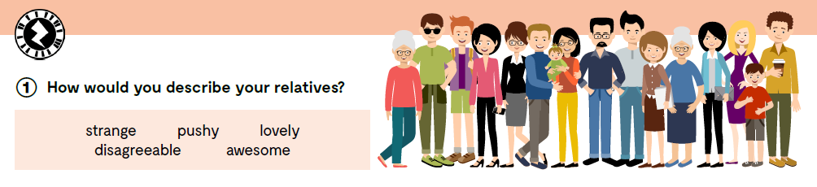
strange
pushy
lovely
disagreeable
awesome
čudan, neobičan
agresivan, naporan
ljupko
neugodan, neprijatan
super, fenomenalan

Slide 3
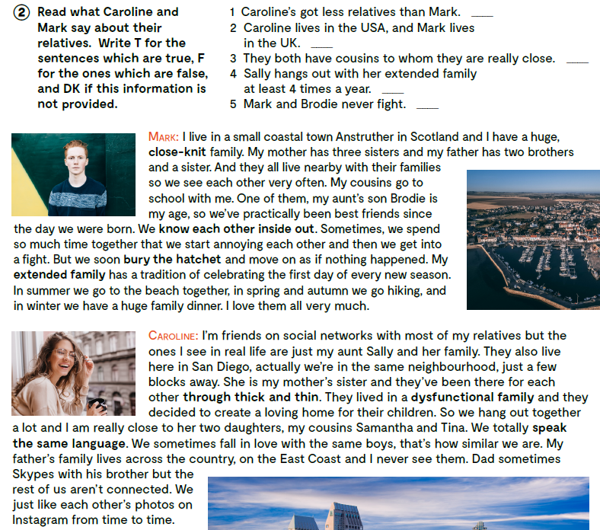

Slide 4
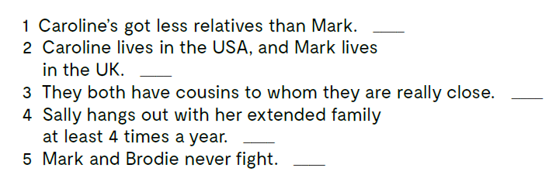
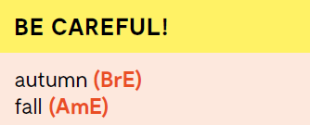
DK
Check your answers.
T
T
Mark and Brody sometimes get into a fight, but they soon bury the hatchet.
DK
F
Do you know the meaning of all the words and expressions.
coastal
close-knit
know each other inside out
bury the hatchet
extended family
through thick and thin
dysfunctional family
speak the same language
obalni
blizak
znati jedno drugo jako dobro, u dušu
zakopati sjekiru, prekinuti svađu
šira obitelj
kroz dobro i loše
disfunkcionalna obitelj
međusobno se dobro slagati, razumjeti jedno drugo
Mark lives in the UK, so he speaks British English, while Caroline speaks American English.

Slide 5
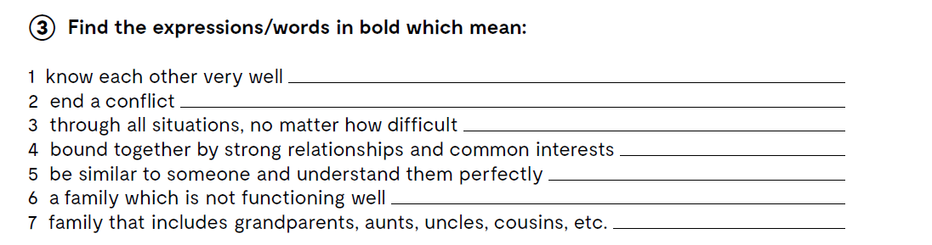
In task 3, page 15, you have to find the expressions/words in bold which mean.
know each other inside out
bury the hatchet
through thick and thin
close-knit
speak the same language
dysfunctional family
extended family
Let’s practise!
https://learningapps.org/watch?v=pidubpqe220

Slide 6
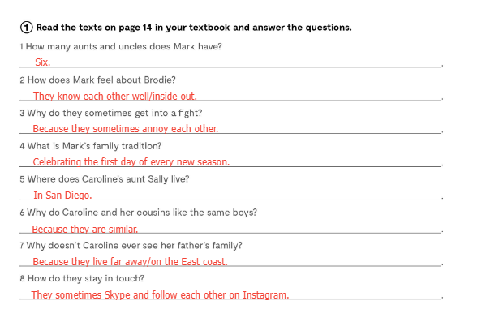
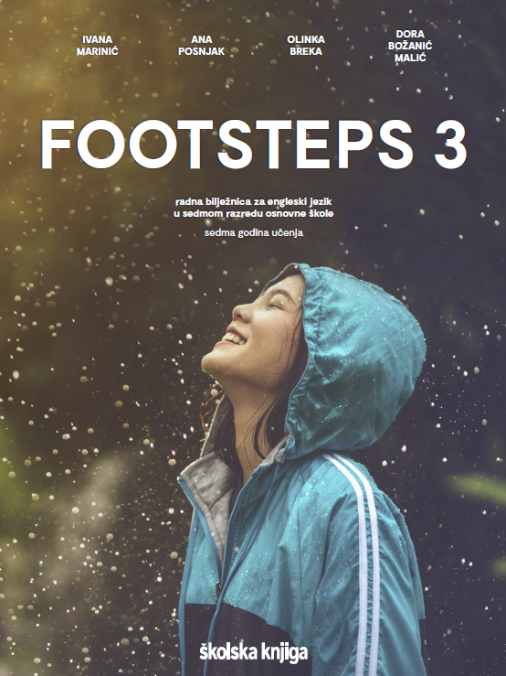
Mark has got six aunts and uncles.

Slide 7
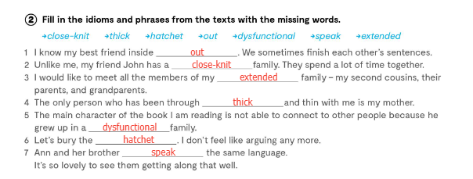
out

Slide 8
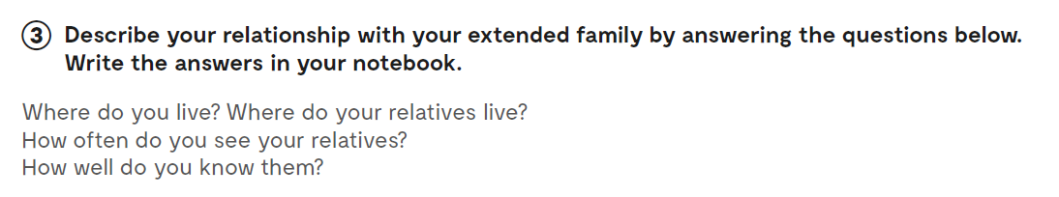
What is your relationship with your extended family?

Slide 9
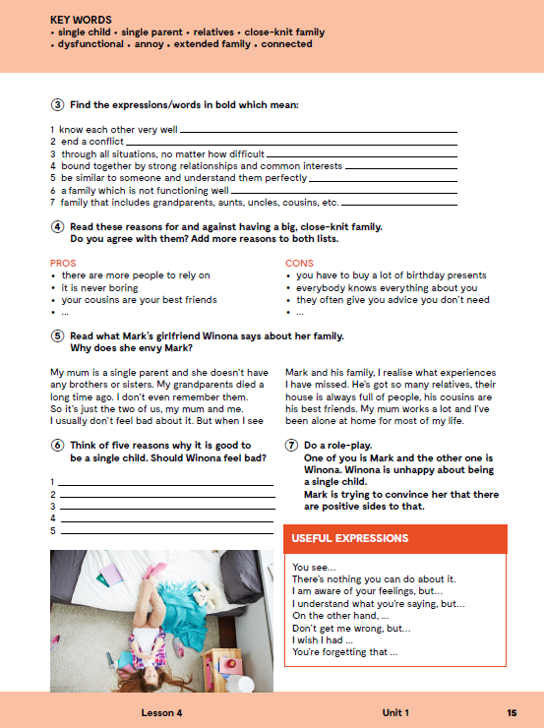
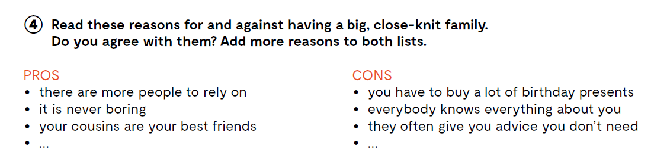
In task 4 read the reasons for and against having a big, close-knit family. Do you agree with them? Add more reasons to both lists.

Slide 10
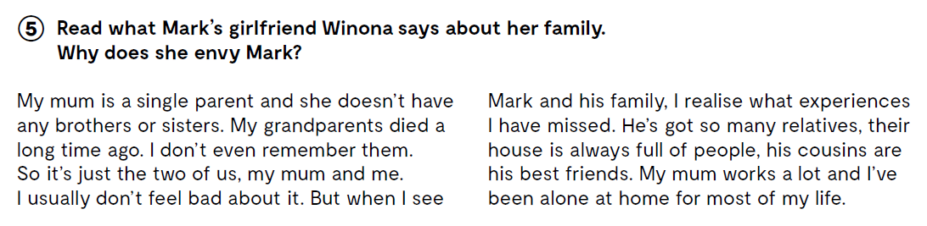
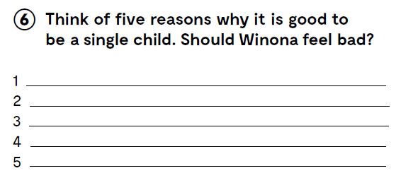
You don’t have to share anything.

